Slide 1





Cost-Effective In-Context Learning for Entity Resolution: A Design Space Exploration
Meihao Fan
Renmin University, China
Xiaoyue Han
Renmin University, China
Ju Fan
Renmin University, China
Chengliang Chai
Beijing Institute of Technology, China
Nan Tang
HKUST (GZ), China
Guoliang Li
Tsinghua University, China
Xiaoyong Du
Renmin University, China
Notes:
Hello everyone，I am Meihao Fan from RenMin university of China,
This paper is titled as <Cost-Effective In-Context Learning for Entity Resolution: A Design Space Exploration> which is a joint work by authors from different institutes.

Slide 2
Entity Resolution (ER)
Entity Resolution refers to the process of deducing whether two entities in tuple refer to the same real-world entity
E.g., matching songs from two tables
Existing methods
Rule-based methods: disjunctive normal form, etc.
Deep Learning-based methods: DeepMatcher^{[1]}, Ditto^{[2]}, etc.
LLM-based methods: CFM^{[3]}, LLM4ER^{[4]}
[1] Mudgal S, Li H, et al. Deep learning for entity matching: A design space exploration. SIGMOD 2018.
[2] Li Y, Li J, et al. Deep entity matching with pre-trained language models. VLDB 2020.
[3] Narayan A, Chami I, Orr L, et al. Can foundation models wrangle your data? VLDB 2022.
[4] Peeters R, Bizer C. Entity matching using large language models. arXiv 2023.
LLM-based methods achieve new SOTA results with much fewer labeled data
Notes:
Entity Resolution…
For example, the figure illustrates matching songs from two tables. The first row records information of a same song which is matched, while the second records different songs, which is no-matched.
There are different methods focus on Entity Resolution. First, rule-based methods use heuristic rules to predict. Secondly, Deep Learning based methods such as DeepMatcher and Ditto utilize deep learning models to predict the matching results. Third, LLM-based methods utilize the power of Large Language Model to deduce whether two serialized entities in tuple refer to the same real-world entity.
Above these three types of methods, LLM-based methods…

Slide 3
LLM-based Entity Resolution
Querying Large Language Model to predict
Task Description describes what ER task refers to.
Demonstrations are labeled entity pairs which LLM can learn from
Question refers to the entity pairs to be predicted
Structure of Standard Prompting
Manually Designing Demonstration
Selecting Demonstration based on similarity metric
Problems: (1) demonstration designing / labeling and (2) API cost are expensive
Notes:
To utilize Large Language Model for ER task, we should first design a prompt consisting of task description, demonstrations and question <as shown in the figure>. Task description describes what ER task refers to, demonstrations are usually labeled entity pairs which LLM can learn from, and the question refers to the entity pairs to be predicted.
To design demonstrations to benefit the predicting accuracy, researchers first design a small validation set to evaluate the quality of current demonstrations and conduct error case analysis to optimize the demonstrations iteratively. Other works propose to select relevant demonstrations based on the similarity metric with the question.
Both methods face two problems. First, the process of demonstration designing or labeling is expensive. Second, since Standard Prompting usually uses multiple demonstrations for one question to ensure the predicting performance, the API cost are usually expensive.

Slide 4
BatchER: A Batch Prompting Framework for ER
Features of BatchER
Supporting batch prompting techniques
Automatically Selecting beneficial demonstrations
Batching questions together to improve predicting accuracy of LLMs
Two Modules in BatchER
Prompt Structure of BatchER
Advantages
Cost-effectiveness
Comparable performance
No need for expert effort to design prompt
Building such a Framework is hard
Hard to design an effective demonstration selection strategy
Hard to ensure the predicting performance of batched questions
Notes:
Thus, we propose BatchER, a Batch Prompting Framework for Entity Resolution.
There are three features of BatchER. First, BatchER …
The main advantages of BatchER are…
However, building such a Framework is hard, since it is hard to … and to ensure

Slide 5
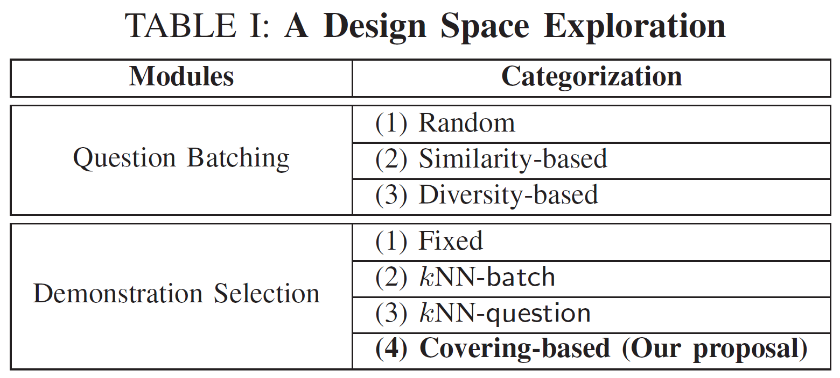
A General Framework of BatchER
Question Batching (1) generates feature vectors then (2) batches with different strategies
Demonstration Selection (1) selects relevant demos from an unlabeled demo pool and (2) manually labels them
Design a method space covering all combination of methods in these two modules to explore
Notes:
The main framework of BatchER is illustrated as below.
There are two modules in BatchER, named Question Batching and Demonstration Selection.
Question batching first … and then …
Demonstration Selection first … and then …
We propose an effective Covering-based Demonstration Selection method and design a method space …

Slide 6
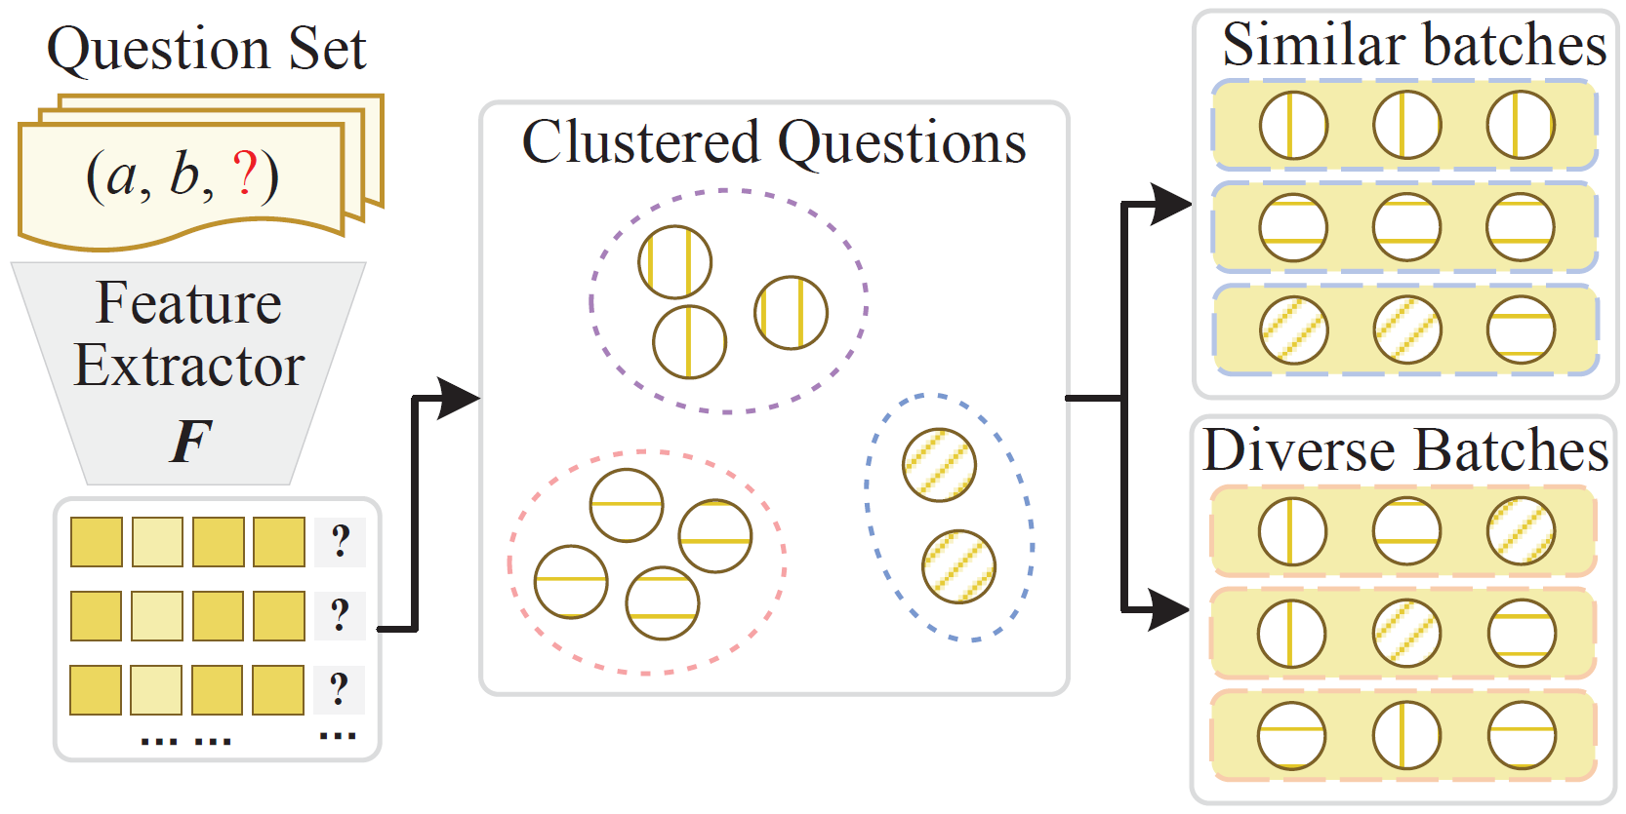
Question Batching
Feature Extractor converts serialized entity pairs into feature vectors. i.e., structural, semantic-based feature extractor
An unsupervised clustering algorithm generates similar clusters for questions based on feature extractors. i.e., K-means, DBScan
Different batching strategies generate question batches based on the clustering results. i.e., random, similarity-based, diversity-based
Notes:
The Figure illustrates the process of Question Batching module.
First, Question Batching usees a Feature Extractor to …
Then, it adopts an Unsupervised clustering … to …
At last, different batching strategies are adopted to …

Slide 7
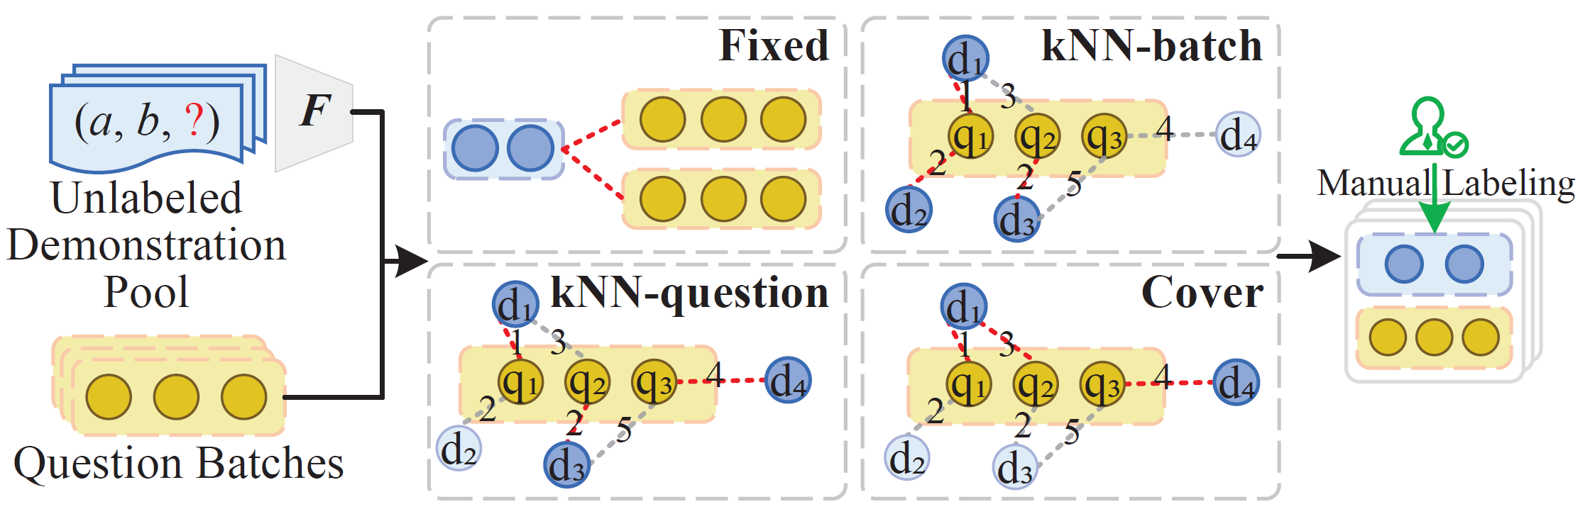
Demonstration Selection
(1) First using different strategies to select demos for each batch from an unlabeled demo pool (2) then manually labeling them
Fixed strategy selects fixed demos and allocates them to all batches
kNN-question selects the top-k nearest demos for each question in the batch
kNN-batch first defines the distance between batches and demos, then selects the top-k nearest demos for each batch
Covering uses demos to cover questions in the batch instead of selecting demos for questions
Notes:
To reduce the labeling cost, Demonstration Selection module propose to … and then …
We propose four different demonstration selection strategies.
The Fixed strategy…
The kNN-question…
The kNN-batch…
And we propose a Covering-based method, which … [ Next, we will further introduce the Covering-based Demonstration Selection strategy.]

Slide 8
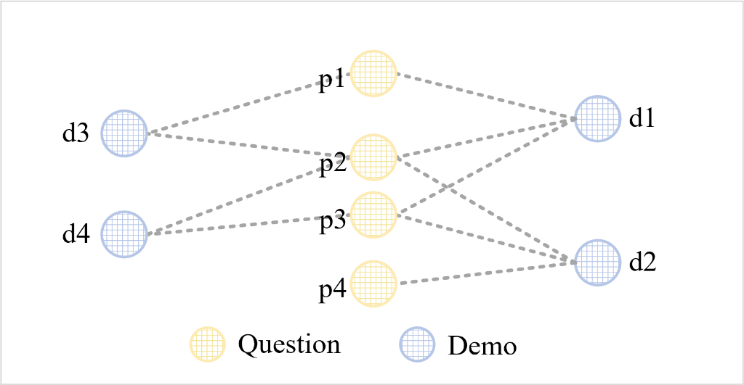
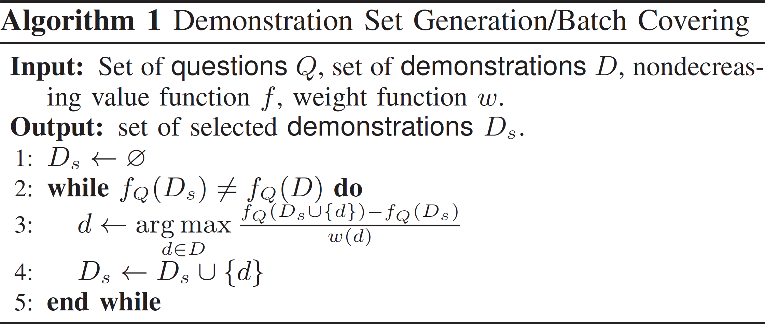
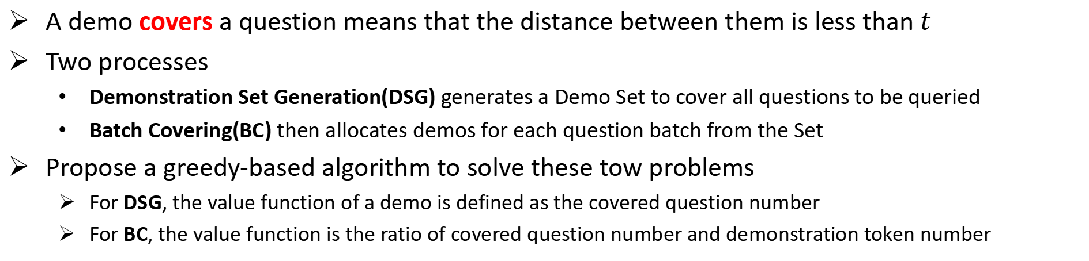
Covering-based Demonstration Selection
A demo covers a question means that the distance between them is less than $t$
Two processes
Demonstration Set Generation(DSG) generates a Demo Set to cover all questions to be queried
Batch Covering(BC) then allocates demos for each question batch from the Set
Propose a greedy-based algorithm to solve these tow problems
For DSG, the value function of a demo is defined as the covered question number
For BC, the value function is the ratio of covered question number and demonstration token number
Notes:
In Covering-based method, a demo covers a question mean that the distance between them is less than a threshold t.
There are two processes in Covering-based method, which we formulate as two questions. Demonstration Set Generation… Batch Covering …
We also propose a … While for different question, we define different weight function. For DSG, … For BC, …
The figure illustration an instance of our proposed method. The orange circles represent the queried questions, the blue circles represent the demonstrations. In Demonstration Set Generation, we iteratively select d-one and d-two which cover the most questions to make up the Demonstration Set. In Batch Covering, we select the shorter demonstration which can cover the p-two and p-three to save the API cost.

Slide 9
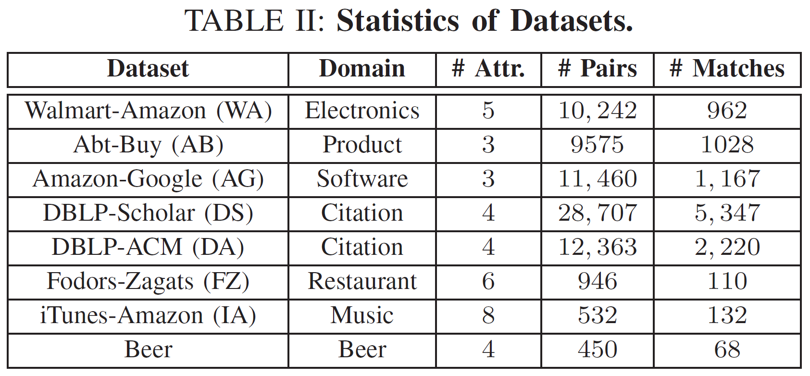
Experiment Setup
We evaluate BatchER on 8 widely used datasets
Different domains
Different sizes
Compare with other methods
LLM-based method: CFM^{[1]}
PLM-based methods: Ditto^{[2]}, JointBert^{[3]}, RoBEM^{[4]}
[1] Narayan A, Chami I, Orr L, et al. Can foundation models wrangle your data? VLDB 2022.
[2] Li Y, Li J, et al. Deep entity matching with pre-trained language models. VLDB 2020.
[3] Peeters R, Bizer C. Dual-objective fine-tuning of BERT for entity matching. VLDB 2021.
[4] Akbarian Rastaghi M, Kamalloo E, Rafiei D. Probing the robustness of pre-trained language models for entity matching. CIKM 2022.
Notes:
We evaluate BatchER on eight widely used datasets of different sizes from different domains. We compare BatchER with other LLM-based method such as CFM and other PLM-based methods such as Ditto, …

Slide 10
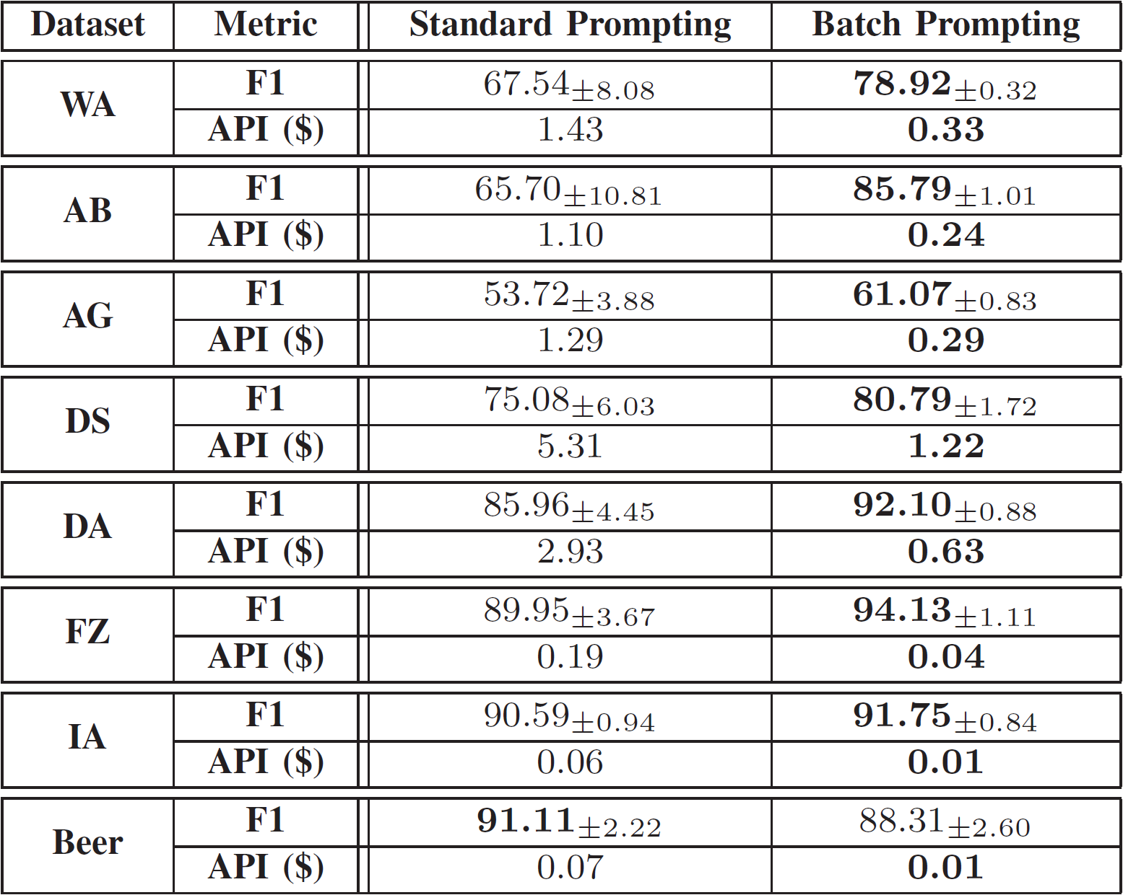
Standard Prompting & Batch Prompting
We compare Batch Prompting to Standard Prompting with fixed demonstrations
Saving 4x~7x API cost
Achieving higher F1 scores
Achieving more stable performance
Cheaper
Better-performed
More stable
Notes:
We first compare Batch Prompting to Standard Prompting technique with fixed demonstrations.
We can see from the figure that Batch Prompting can save 4 times to 7 times API cost while achieving higher F1 scores and more stable performance, showing that Batch Prompting is a much cheaper while better-performed and more stable method.

Slide 11
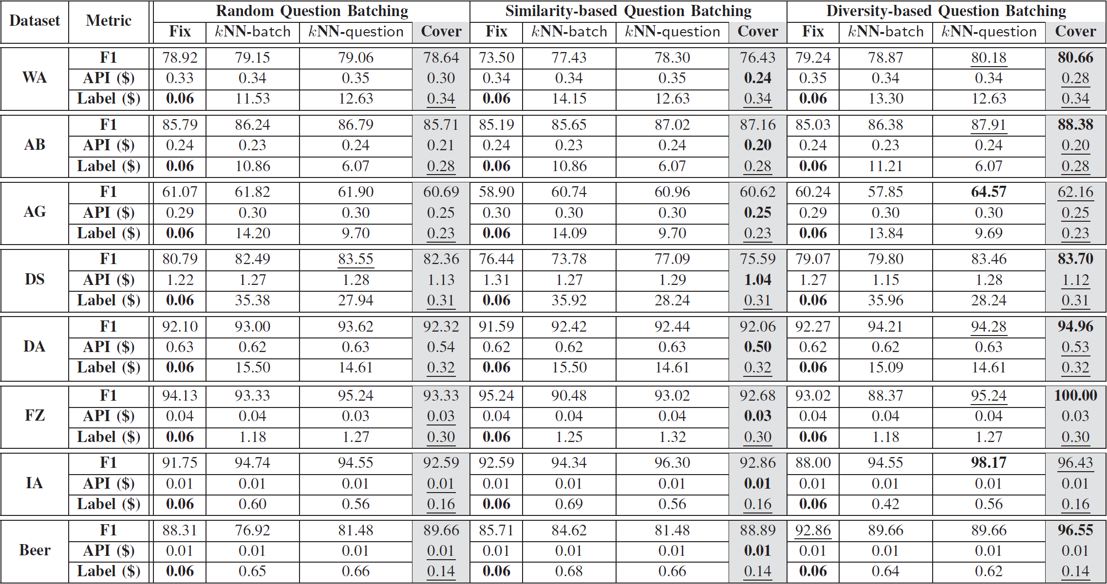
Design Space Evaluation
We evaluate BatchER with different Question Batching and Demo Selection methods
Cover greatly reduces the labeling cost
Diverse batches have the highest F1 score
Diverse batches with covering-based demo selection achieve the best trade-off
Notes:
Then, we evaluate…
The experimental results show that
The Covering-based Demonstration Selection greatly reduces the labeling cost.
Also, the Diverse batches have the highest F1 scores
At last, the diverse batches with covering-based demonstration selection achieve the best trade-off between cost and performance.

Slide 12
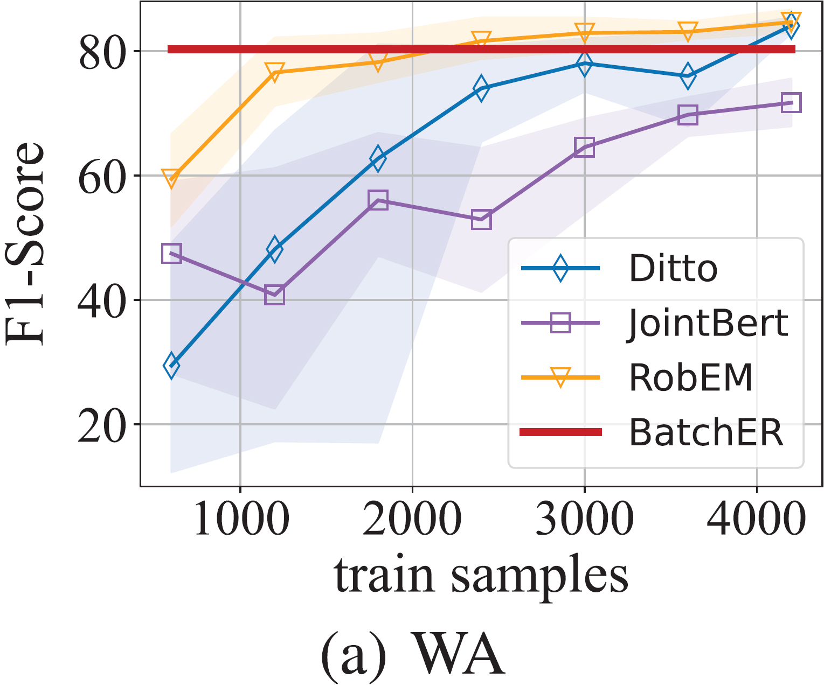
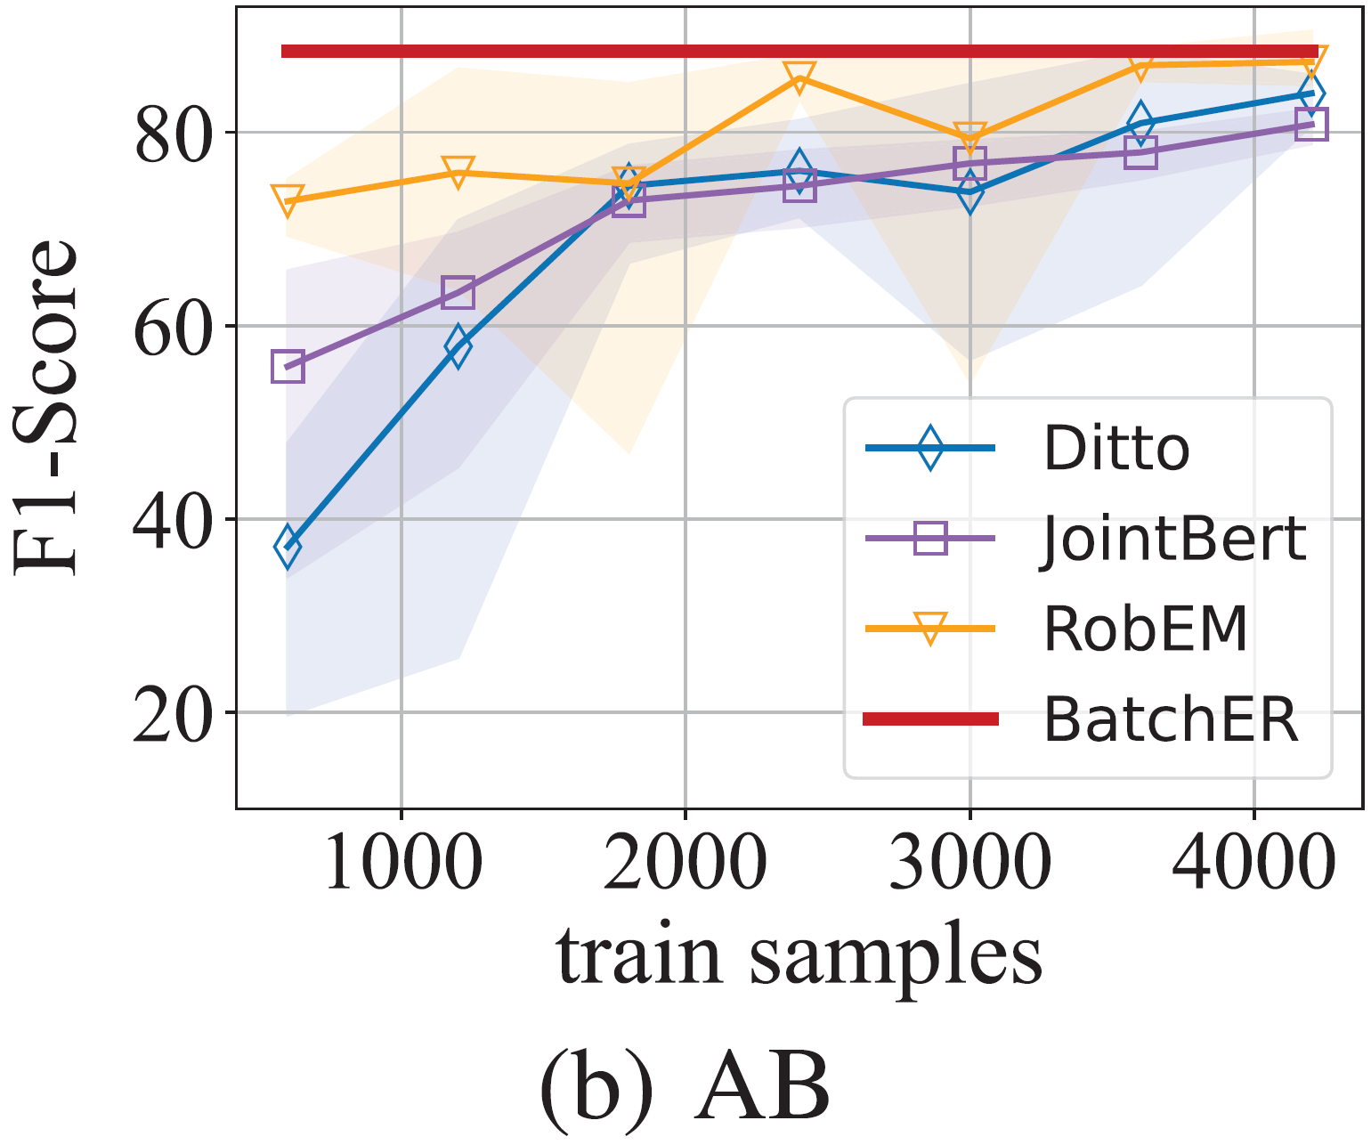
Comparing with PLM-based method
We compare BatchER with PLM-based methods trained on thousands of labeled data
BatchER only requires 20~40 labeled data
Saving hundreds to thousands labeled data
Achieving comparable or even better performance
Similar observation can be got from other datasets.
Notes:
We also compare …, such as Ditto, JointBERT and RobEM.
We can see from the figure that BatchER can save … while achieving …
Similar observation can be got from other datasets, which is reported in our paper.

Slide 13
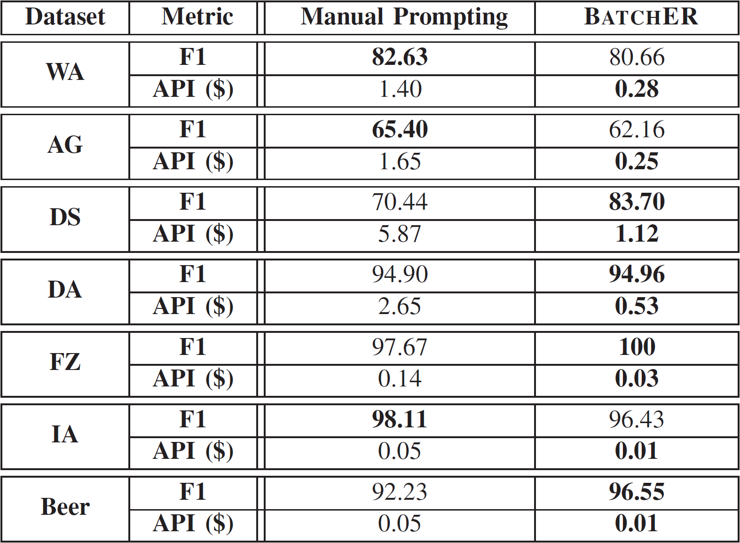
Comparing with LLM-based method
We compare BatchER with the LLM-based method
BatchER achieves comparable or even better performance
BatchER saves 80% API cost
Automatically select beneficial demonstrations (no need for expert effort to design prompt)
Notes:
Finally, we campare BatchER with …
We can see from the table that
BatchER … with only 20 percent API cost
BatchER can … thus, it is no need for …

Slide 14
Conclusion
We propose BatchER, a cost-effective Batch Prompting framework utilizing Large Language Model for Entity Resolution task.
We propose a covering-based demonstration selection method to effectively select demonstrations for batch prompting
We conduct experiments on 8 widely used datasets, and show that BatchER is comparable or even better than SOTA PLM-based and LLM-based models with much fewer costs, which verifies the cost-effectiveness.
Notes:
To conclude, we … . Also, we …. Finally, we …

Slide 15
Thanks
Notes:
Thank you for your listening. If anyone have a question, Let me know.

